Slide 1



Project Proposal
Face Restoration with multiple conditions diffusion model
Presentation
Team 14
Notes:
Hello everyone. We're Team 14, and our project is about faces inpainting restoration using a diffusion model with multiple conditions.

Slide 2
01 -Motivation
02-Related Works
03-Proposed Method
04-Expected Results
OUTLINE
Notes:
Here's a quick outline of our presentation. We'll cover our Motivation, Related Works, Proposed Method, Expected Results

Slide 3

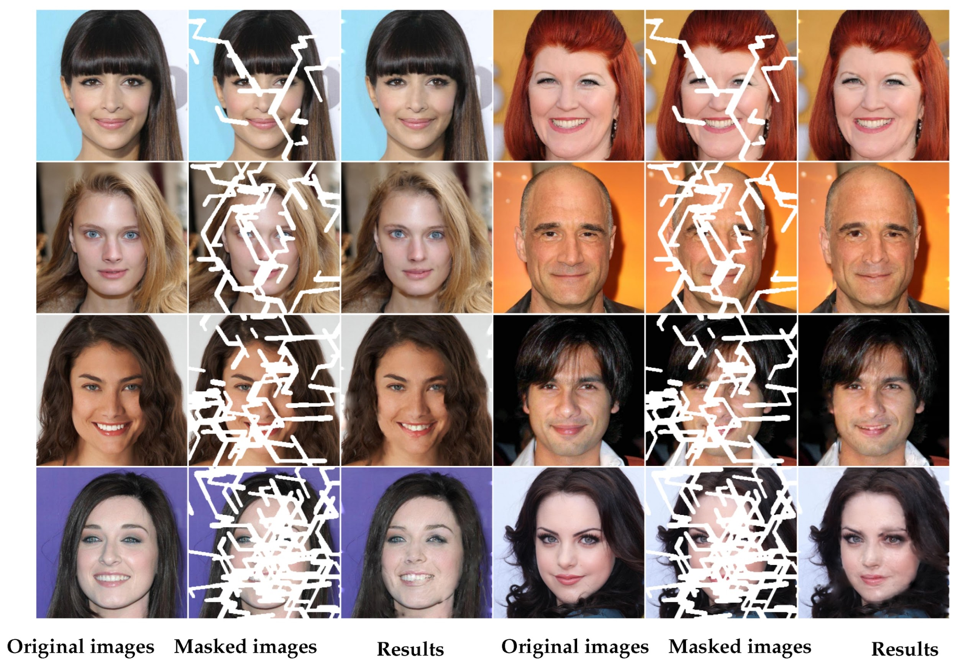
01 - Motivation
Task:
Face Inpainting Restoration with conditional diffusion model
Objective:
Exploring better while modeling for the conditional diffusion model
Notes:
Our project task focuses on Face Inpainting Restoration using conditional diffusion models. The main object is to explore better ways to model these conditions to improve how we guide based on the degraded images

Slide 4
01 - Motivation
Explore more and better conditions
Based on degraded images
Extract High/Low-level information from degraded images
Effectively feed multiple conditions into the diffusion model
Fine-tuning the diffusion model is costly → Keep minimum modification
Notes:
Specifically, we want to find more effective conditions derived directly from the degraded images. This includes extracting both high-level (semantic) information and low-level (structural) details. A key challenge is integrating multiple conditions effectively while making minimal changes to the expensive pre-trained diffusion model

Slide 5
02 - Related Work
List of Related work
DA-CLIP
CLIP-SMU
T2I Adapter
LaFIn
(ICLR 2024)
(WACV 2025)
(AAAI 2024)
(PRCV 2020)
Notes:
Now, let‘s look at some Related Works that influence our approach. We’ll briefly touch upon DA-CLIP, CLIP-SMU, T2I-Adapter, and LaFIn, most of them are from recent top-conferecnes

Slide 6

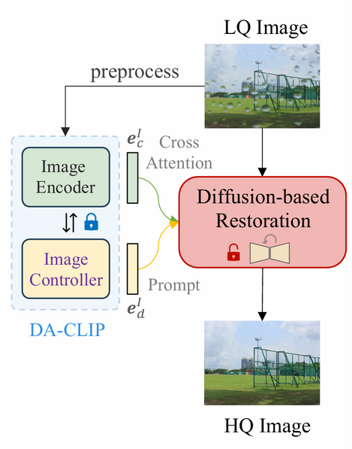
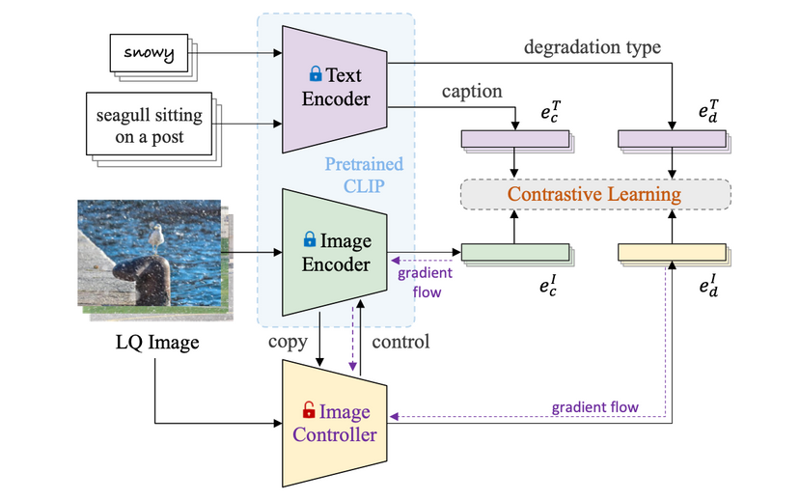
DA-CLIP (ICLR 2024)
Related work #1
CONTROLLING VISION-LANGUAGE MODELS FOR MULTI-TASK IMAGE RESTORATION
VLMs (e.g., CLIP) perform poorly on corrupted inputs
Proposed Degradation-Aware CLIP
Train a controller to adapt the fixed CLIP to LQ inputs, predicting original and degradation embeddings.
Take as a condition for diffusion models, enabling multi-task restoration.
Notes:
First, let's look at DA-CLIP. DA-CLIP addresses the issue that vision language models like CLIP struggle with low-quality images, that means it can't generate good description about the content. It uses a small controller to help a fixed CLIP understand degraded inputs and predict both content and degradation type. These predictions can then condition a diffusion model for restoration

Slide 7
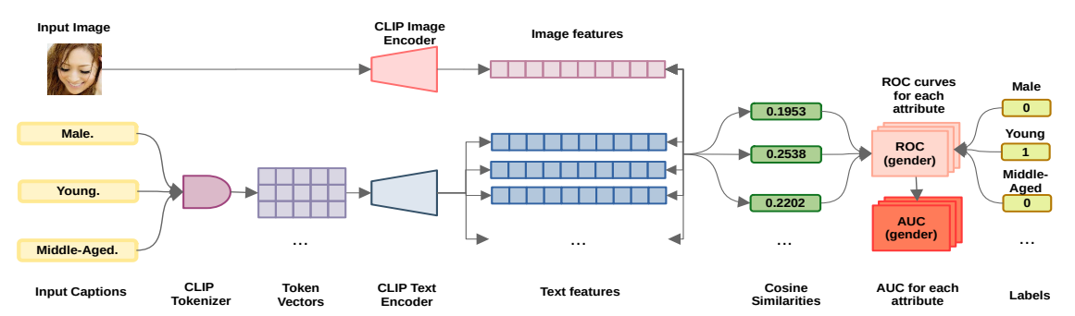
CLIP-SMU (WACV 2025)
Related work #2
Interpreting Face Recognition Templates using Natural Language Description
Aligns face image embeddings and caption-based text features using CLIP
Computes cosine similarity between them
Evaluates attribute presence via ROC / AUC
Notes:
CLIP-SMU is designed to interpret face recognition templates using natural language. The pipeline starts by feeding a face image into a CLIP Image Encoder to extract image features. At the same time, a set of predefined facial attributes (like “Male,” “Young,” and “Middle-Aged”) are converted into text features using the CLIP Text Encoder. Then, the model computes cosine similarities between the image and each text feature to estimate the presence of each attribute. Finally, they use ROC curves and AUC scores to evaluate how well these attributes are. This structure offers a more interpretable and fine-grained semantic representation, we think it is helpful for face restoration.

Slide 8
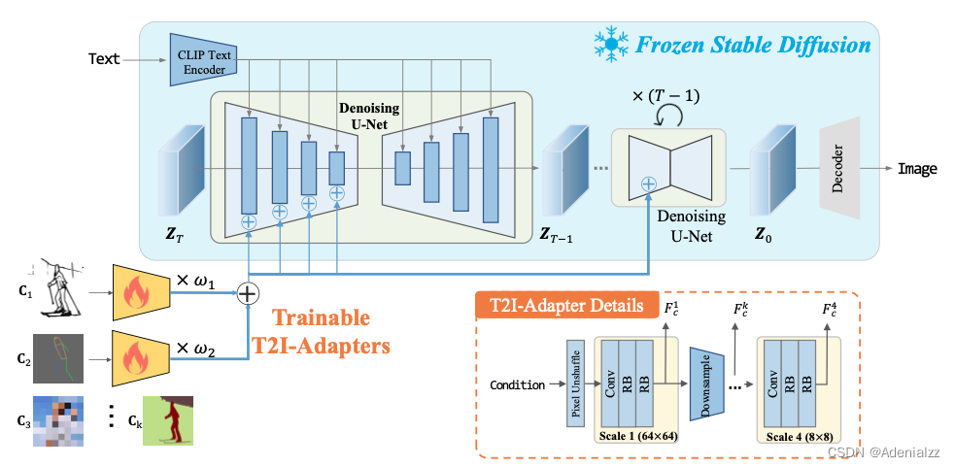
T2I-Adapter (AAAI 2024)
Related work #3
T2I-Adapter: Learning Adapters to Dig out More Controllable Ability for Text-to-Image Diffusion Models
Text-only conditions lack precise control
Enable Multi-condition control without modifying the base model
Propose T2I Adapter aligns conditions (e.g., sketch, color) to different-scale features from UNet intermediate layers
Notes:
T2I-Adapter propose a method that enable multi-condition control without modifying backbone diffusion model instead of just using text. Specifically it adds small, trainable 'Adapters' that allow you to guide the image generation with other conditions, like sketches or depth maps. The key benefit is that these adapters are lightweight and don't require changing the main, expensive pre-trained diffusion model, making it efficient to adapt the model for new tasks or controls

Slide 9
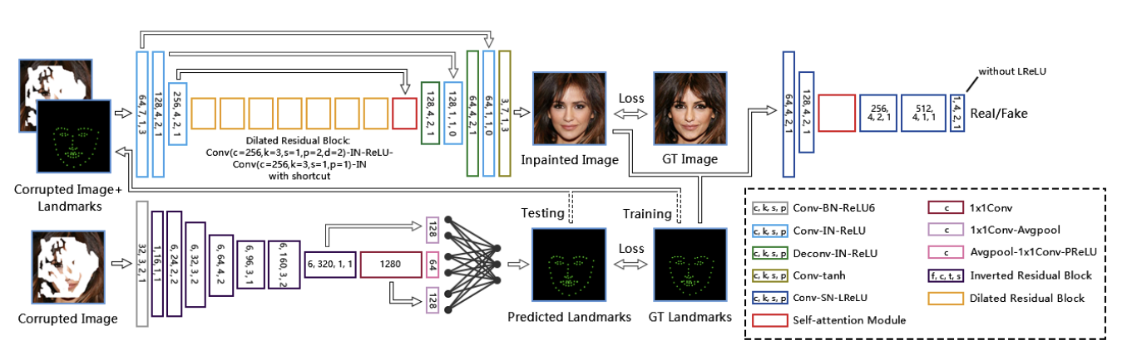
LaFIn (PRCV 2020)
Related work #4
LaFIn: Generative Landmark Guided Face Inpainting
Two Stage:
Landmark Completion Module (LCM)
Predicts a complete facial landmark heatmap
Based on a U-Net architecture
Face Inpainting Module (FIM)
Input: masked face image + landmark heatmap
Notes:
Finally, LaFIn is a two-stage face inpainting model guided by facial landmarks. The first stage is the Landmark Completion Module, or LCM. This module predicts the complete facial landmarks from a masked or occluded face image. This module is based on a U-Net Encoder architecture, and incorporates dilated residual blocks to capture long-range dependencies. The second stage, the Face Inpainting Module (FIM), then takes the original masked image and the predicted complete landmarks to synthesize the restored face. This process uses the landmarks as a structural guide, which helps preserve facial geometry and improves the realism of the result

Slide 10
03-Proposed Method
Based on Pretrained Latent Diffusion Models
Encoding LQ image to different levels of conditions
High level: Prompt Embedding
Low level: Face Landmark information
Cooperate the conditions to diffusion with the Adapter
Notes:
Now, for our Proposed Method. We build on pre-trained diffusion models. The key idea is to extract multiple conditions from the low-quality input: high-level semantics (like attributes) and low-level structure (like landmarks). We'll use an Adapter mechanism, inspired by T2I-Adapter, to combine these conditions and guide the diffusion model efficiently

Slide 11
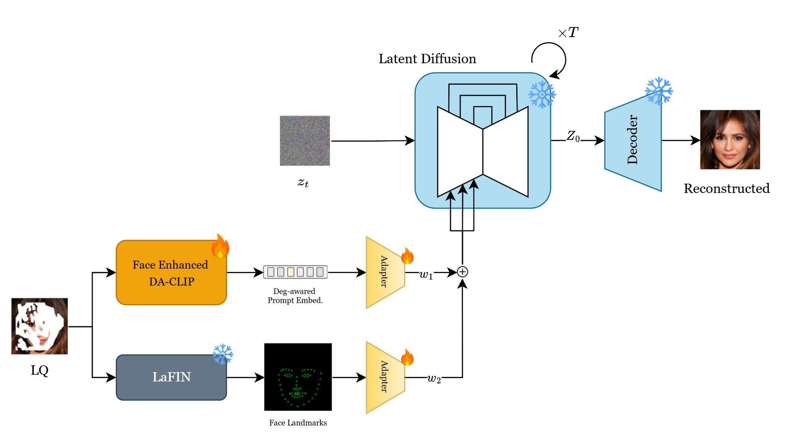
Pipeline
Notes:
First, we extract conditions from the low-quality input image. For high-level semantic information, we fine-tune DA-CLIP, using CLIP-SMU ‘s method to focus on face attributes. For low-level structural information, we use a pre-trained LaFIn model to get facial landmarks.
Second, we train the Adapters, one for each condition type please note that the backbone diffusion model be fixed and the adapters will learn to map the extracted conditions into control signals that are injected into different layers of the diffusion U-Net, guiding the restoration process.

Slide 12

04 - Expected Results
Datasets
Baseline & Evaluation
Notes:
Finally, let's discuss the expected results of our experiment. We'll cover the datasets used, the baselines for comparison, and the evaluation metrics

Slide 13
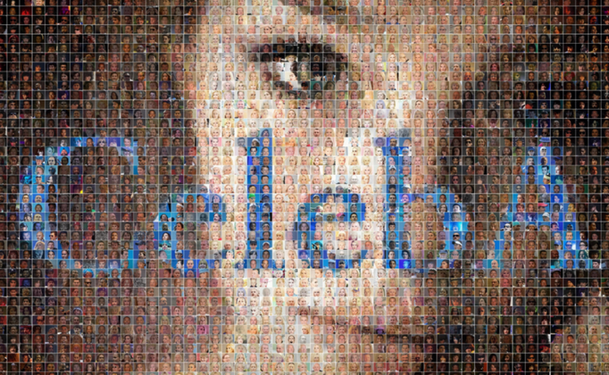
CelebA-HQ dataset
Datasets
30,000 images at 1024×1024 resolution
Train/Test: 29000/100
Resize to 256x256 for faster training and inference
Masks provided by RePaint (Lugmayr et al., 2022)
Notes:
We'll use the CelebA-HQ dataset, which has 30,000 high-res face images
For the faster training, we will resize them to 256x256.
for the mask, We'll use standard masks, possibly from the RePaint method, for tasks like inpainting

Slide 14

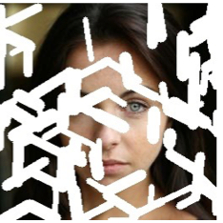
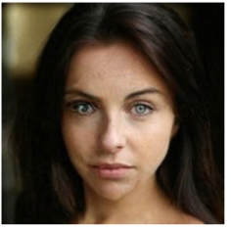
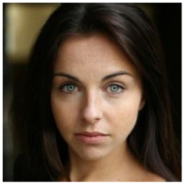

Baseline & Evaluation
Baseline
RePaint(CVPR2022)
IR-SDE(ICML 2023)
DA-CLIP(ICLR 2024)
Evaluation
Distortion: PSNR/SSIM
Perception: LPIPS/FID
Expecting Result
before
after
(DA-CLIP)
Notes:
To see how well our method works, we'll compare it against Baselines like RePaint, IR-SDE, and DA-CLIP.
We'll use standard Evaluation metrics: PSNR and SSIM for pixel accuracy, and LPIPS and FID for perceptual quality and realism.
We aim for produce strong results that can outperform these baselines

Slide 15
Thanks

Slide 16
References
https://arxiv.org/pdf/2310.01018
https://arxiv.org/pdf/1911.11394
https://openaccess.thecvf.com/content/WACV2025W/RWS/papers/Manojlovska_Interpreting_Face_Recognition_Templates_using_Natural_Language_Descriptions_WACVW_2025_paper.pdf
https://ojs.aaai.org/index.php/AAAI/article/view/28226
https://medium.com/@bhushan.shashank93/a-guide-to-diffusion-based-image-generation-ee3ded234fbd
https://www.researchgate.net/figure/The-generation-process-of-ground-truth-facial-boundary-heatmaps-a-HR-face-images-b_fig5_340390738
https://mmlab.ie.cuhk.edu.hk/projects/CelebA.html

